Slide 1
What makes a website

Slide 2

This is the internet
The internet is a global system of interconnected computer networks.

Slide 3
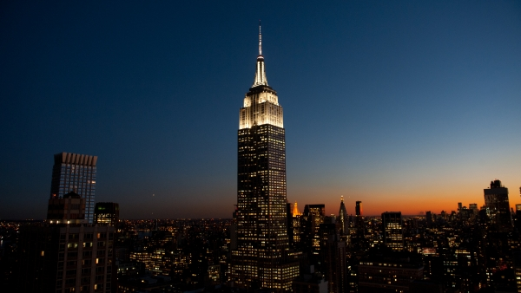
This is a website
A location connected to the Internet that maintains one or more pages on the World Wide Web.

Slide 4
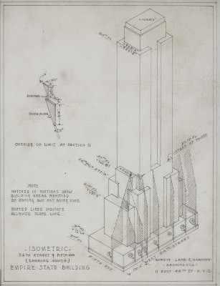
This is a wire frame
A skeletal model in which only lines and vertices are represented.
an image or set of images which displays the functional elements of a website or page, typically used for planning a site's structure and functionality.

Slide 5
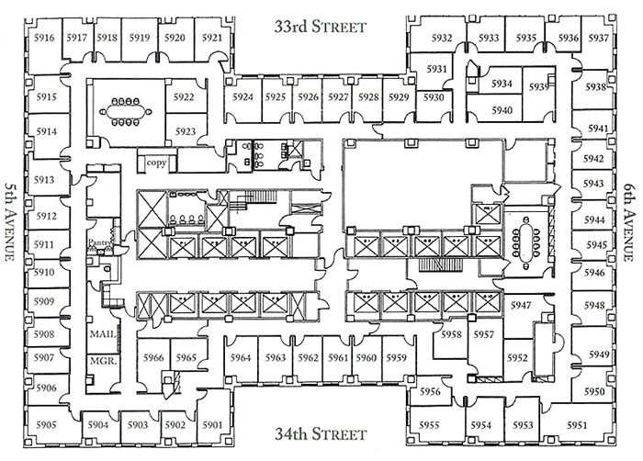
This is a flow chart
a diagram of the sequence of movements or actions of people or things involved in a complex system or activity.

Slide 6
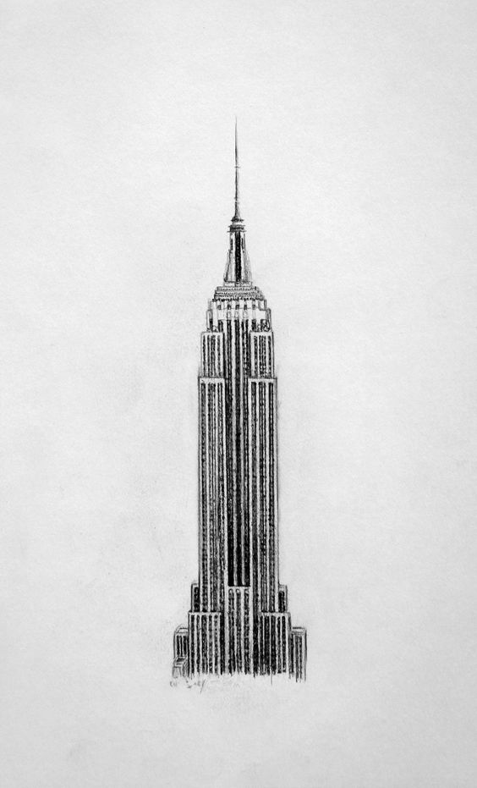
This is a mock up
A mockup is a realistic representation of what the product will look like

Slide 7
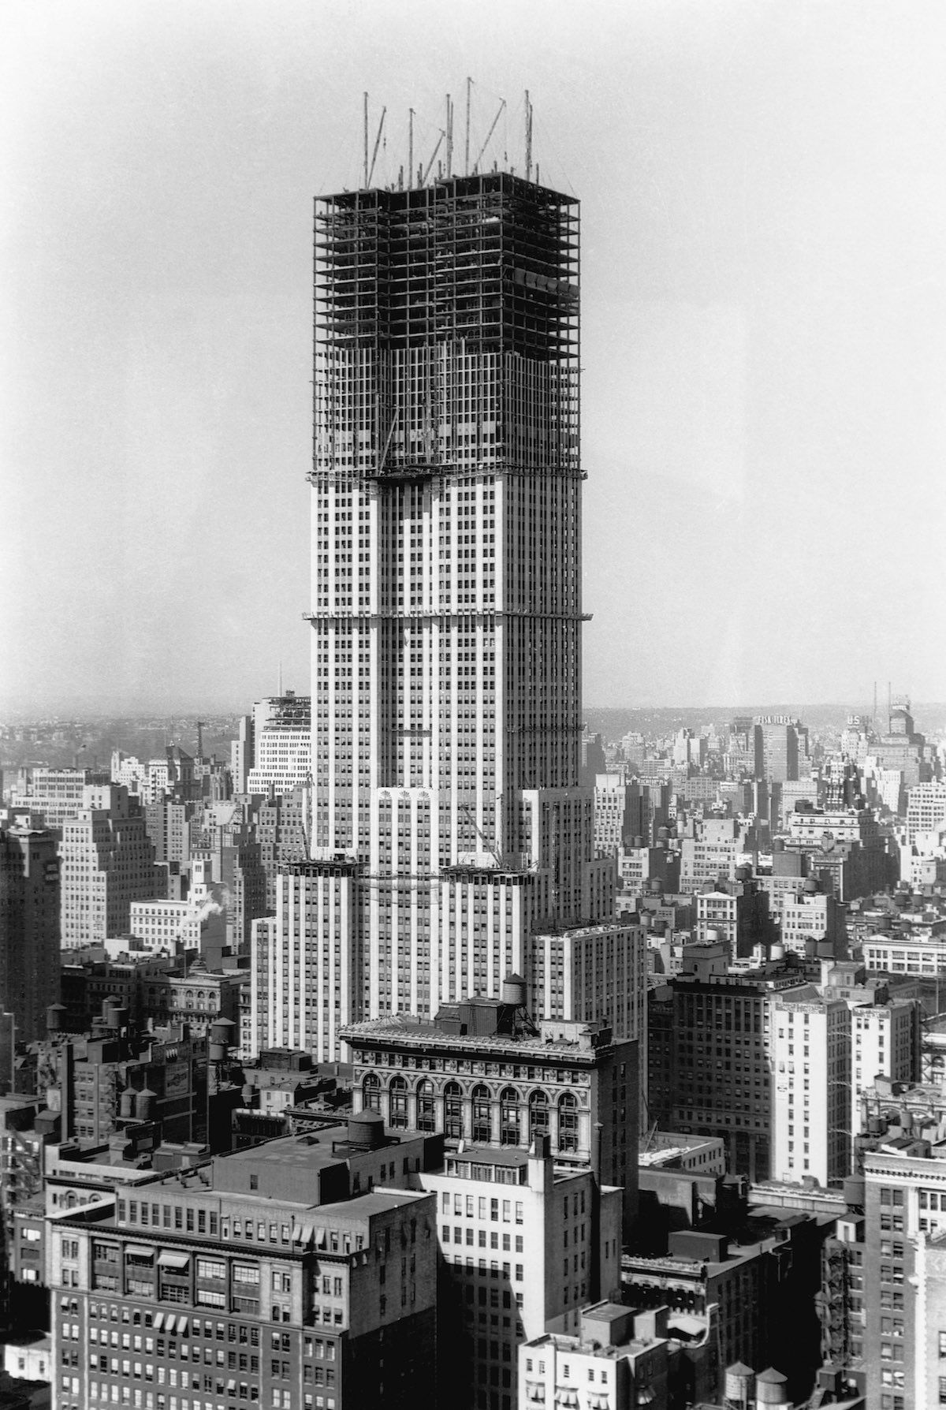
This is HTML
Hypertext Markup Language, a standardized system for tagging text files to achieve font, color, graphic, and hyperlink effects on Web pages.

Slide 8
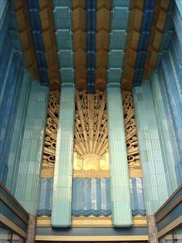
This is CSS
CSS stands for Cascading Style Sheets. CSS describes how HTML elements are to be visually displayed on screen, paper, or in other media

Slide 9
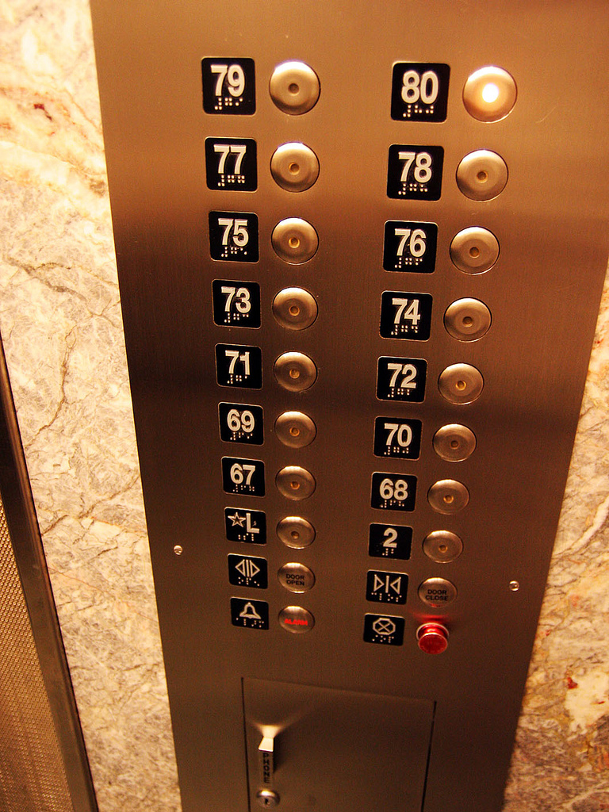
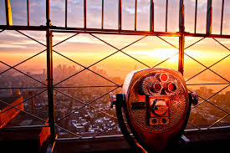
This is JavaScript
an object-oriented computer programming language commonly used to create interactive effects within web sites.

Slide 10
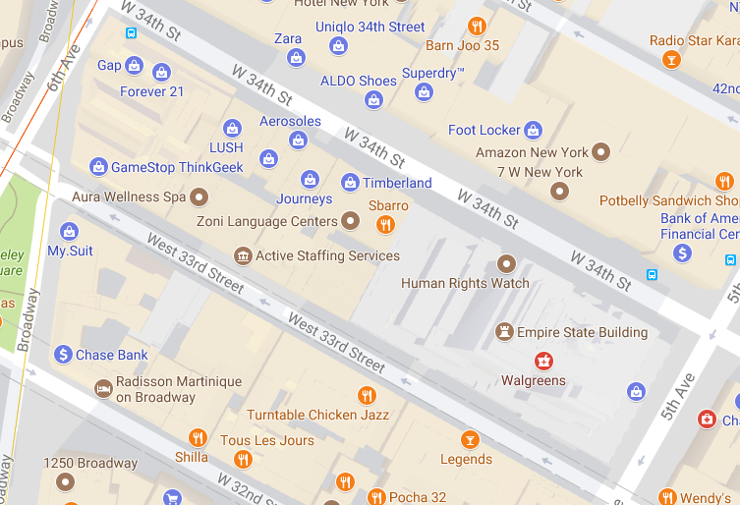
This is a server
A server is a a software program, or the computer on which that program runs, that provides a specific kind of service to client software running on the same computer or other computers on a network. ... It is a major element of modern operating system and network design.

Slide 11

This is php
PHP is a server-side scripting language designed primarily for web development. It runs code to create functionality from the server into the website and back.

Slide 12
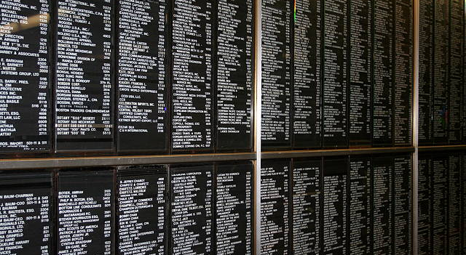
This is mySQL
MySQL is a standardized programming language used for managing relational databases and performing various operations on the data in them.

